Slide 1
Power series
Da Zhou （周达）
zhouda@xmu.edu.cn

Slide 2
How to define a function
By mapping rules (e.g. elementary function)
By equations (e.g. implicit function)
By Integral (e.g. Gamma function)
…

Slide 3
Series with function terms

Slide 4
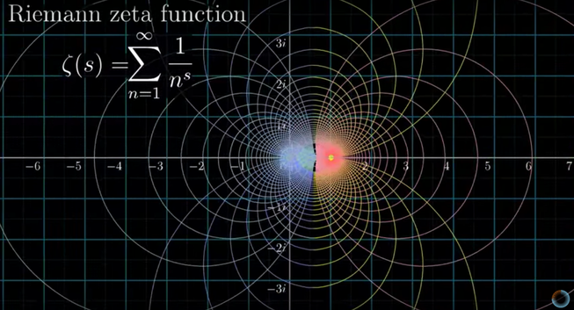
Series with function terms

Slide 5
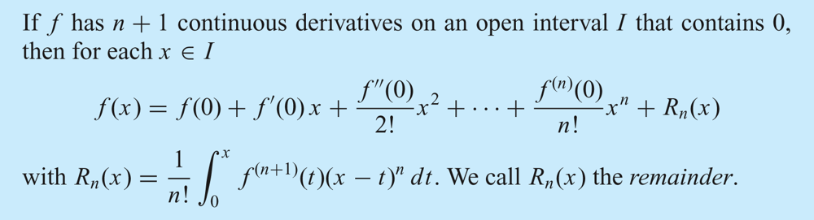
Taylor Polynomials in x

Slide 6
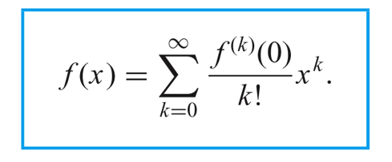
Taylor series in x

Slide 7
Taylor series in x

Slide 8
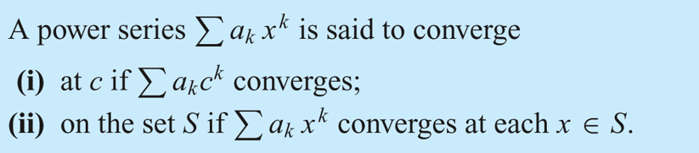
Power series and its convergence

Slide 9
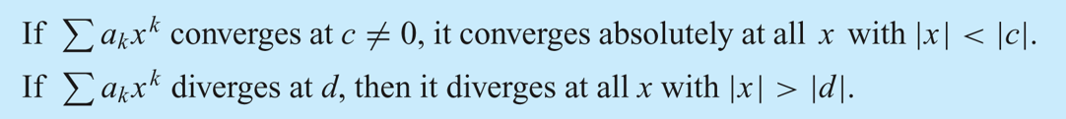
Abel’s Theorem

Slide 10
Corollary of Abel’s Theorem
Case 1. The series converges only at x = 0. This is what happens with
For x ≠ 0, k^{k} x^{k} 0, and so the series cannot converge.
Case 2. The series converges absolutely at all real numbers x. This is what happens with the exponential series
Case 3. There exists a positive number r such that the series converges absolutely for |x| < r and diverges for |x| > r . This is what happens with the geometric series
Here there is absolute convergence for |x| < 1 and divergence for |x| > 1.

Slide 11
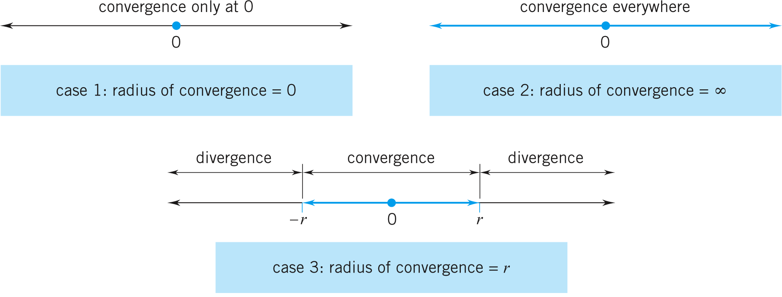
Radius of convergence
Associated with each case is a radius of convergence:
In Case 1, we say that the radius of convergence is 0.
In Case 2, we say that the radius of convergence is ∞.
In Case 3, we say that the radius of convergence is r.

Slide 12
Radius of convergence
For

Slide 13
Radius of convergence
For
Please think about

Slide 14
Domain of convergence
Step 1: calculate the radius r of convergence
Step 2: test the convergence of the series at x=r and x=-r
Step 3: write the domain of convergence

Slide 15
Determine the domain of convergence of the following power series

Slide 16
Determine the domain of convergence of the following power series

Slide 17
Determine the domain of convergence of the following power series

Slide 18
Determine the domain of convergence of the following power series

Slide 19
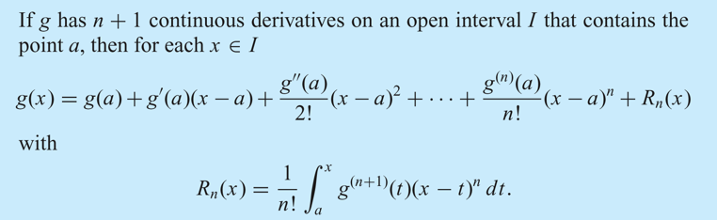
Taylor Polynomials in x-a

Slide 20
Determine the domain of convergence of the following power series

Slide 21
Determine the domain of convergence of the following power series

Slide 22
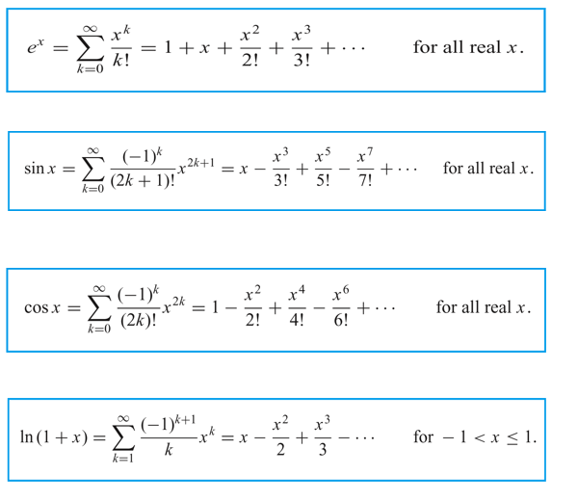
Power series expansion of f(x)
Domain of convergence

Slide 23
Newtonian Binomial Law

Slide 24
Can we expand f(x) without using direct derivation?

Slide 25
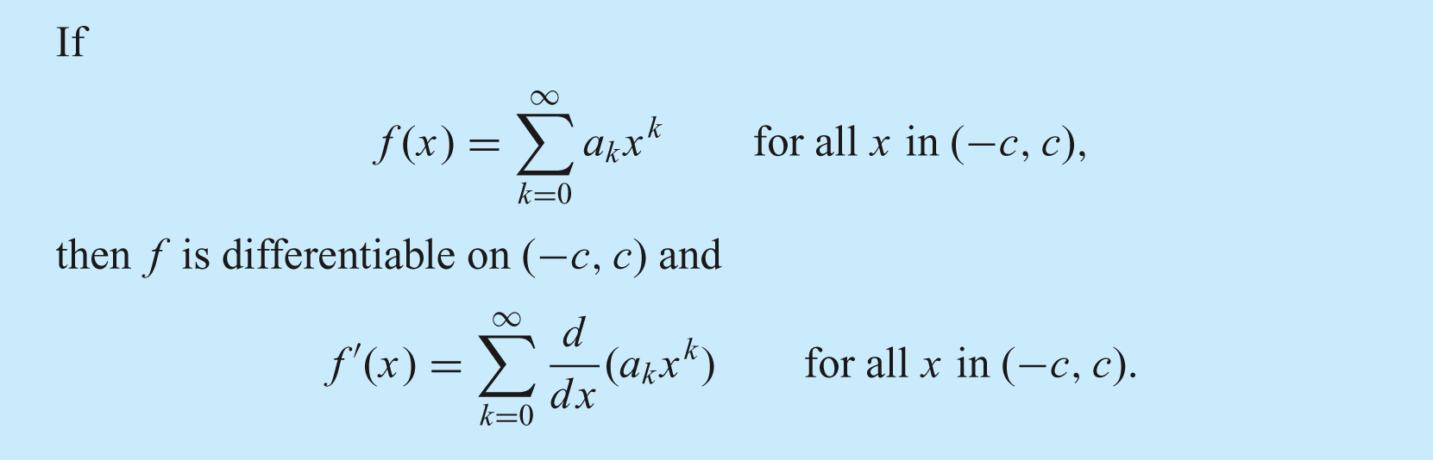
The Differentiability Theorem

Slide 26
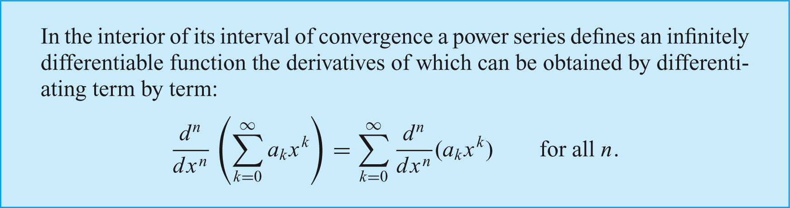
The Differentiability Theorem

Slide 27
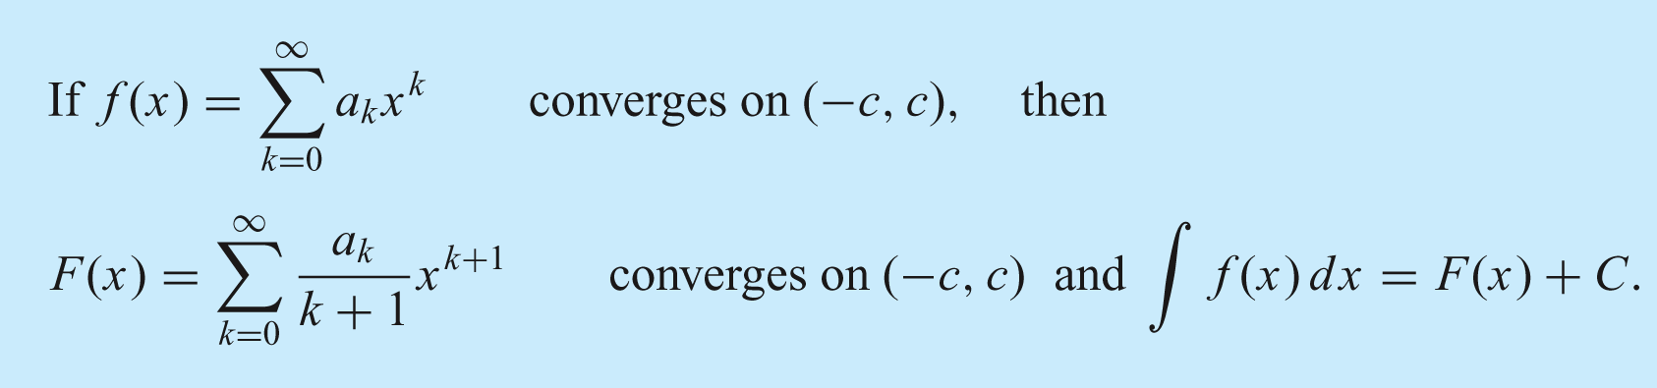
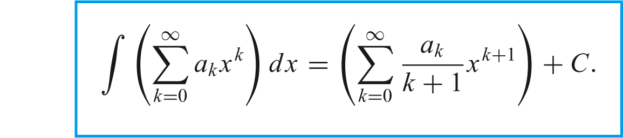
The integrability Theorem

Slide 32
Problems in power series
Determine domain of convergence
Expand function as power series at x=x₀
Solve sum of power series

Slide 33
Solving the sum of

